Slide 1
Role Of An Information Security Manager
The Information Security Manager (Head Of Information Security or CISO) is delegated and authorized by senior management to run the Information Security program and meet its objectives

Slide 2
Role Of An Information Security Manager
The Information Security Manager develops a policy to regulate the Information Security program which is signed off by senior management
Assigned resources and authority to plan, assess, implement, monitor, test, and accredit the Information Security activities

Slide 3
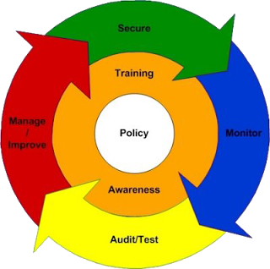
Role Of An Information Security Manager
http://www.shortinfosec.net/2009/11/role-of-information-security-manager.html

Slide 4
Role Of An Information Security Manager
InfoSec Manager Tasks:
Develop policy
Training & awareness
Design security architecture
Design security controls
Ensure controls are implemented
Conduct risk assessment

Slide 5
Role Of An Information Security Manager
InfoSec Manager Tasks (Contd):
Conduct security testing
Monitor vulnerability management program
Facilitate incident management process
Sign-off critical change management activities

